Slide 1
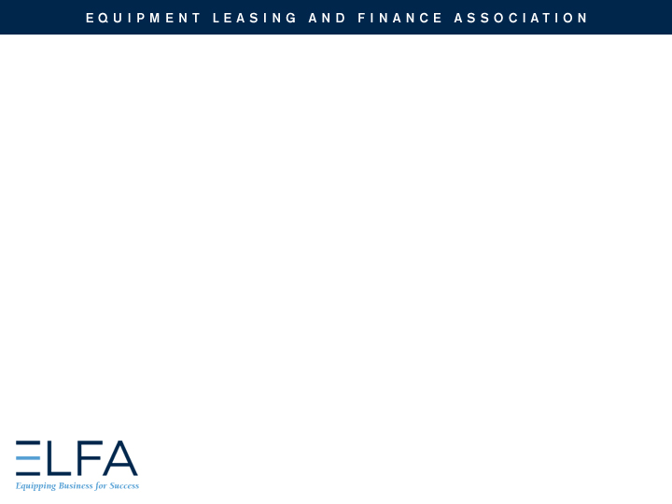

EQUIPMENT LEASING AND FINANCE
A Progressive, Global Industry

Slide 2
Name
Title
Organization
url
logo

Slide 3
Agenda
Industry Overview
Who uses Equipment Finance and Why?
Capital Markets
Career Paths
Q&A

Slide 4
Industry Overview

Slide 5

Industry Overview
Most businesses require equipment in order to operate and grow and, for a majority of businesses, equipment financing is a key acquisition strategy.
Domestically, equipment finance accounts for $1.046 trillion of business each year.
Each year American businesses, nonprofits and government agencies invest over $1.584 trillion in capital goods and software (excluding real estate).
Some 67%, or $1.046 trillion, is financed through loans, leases and other financial instruments.
        The key aspect to understand about equipment finance is that it is one of the most important ways for businesses to invest in capital while managing their balance sheets, taxes and cash flow.

Slide 6
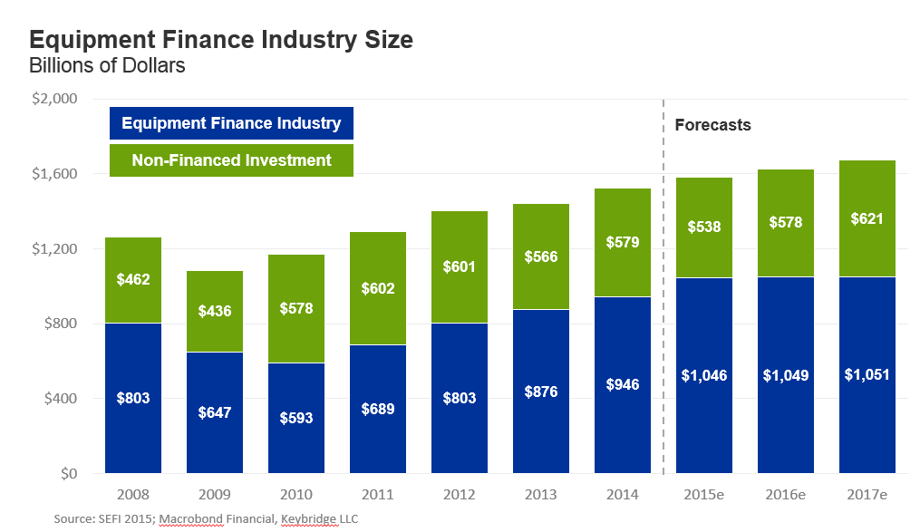

Equipment Finance on the Rise
The equipment finance industry is poised to reach the $1 trillion level in 2015 and is entering a new phase of solid but slower growth.

Slide 7
Industry Overview
The assets that a business may need to finance are varied; examples include:
      Agricultural equipment
      Commercial and corporate aircraft
      Manufacturing and mining machinery
      Rail cars and rolling stock
      Vessels and containers
      Trucks and transportation equipment
      Construction and off-road equipment
      Business, retail and office equipment
      Medical technology and equipment
      IT equipment and software

Slide 8
Industry Overview
WHO ARE THE PLAYERS?
Banks | Banks finance the sale or lease of equipment. Banks may offer lease financing as one of their financial products in order to provide their customers with a full range of financial services.
Captives | Captives are companies set up by a manufacturer or equipment dealer to finance the sale or lease of its own products to end-users.
Independent | An independent leasing company is one that is not affiliated with another company. Independent leasing companies vary greatly in the products and services they offer. They may be generalists or they may specialize by ticket size, by equipment type, or by other criteria.
Brokers | Brokers establish a relationship with the CFO, assess their equipment financing need, and help determine the best product and structure to meet this need. The Broker then presents the deal to several sources to find the best funding partner. Brokers earns fees for services from either Company or the Funding Source.

Slide 9










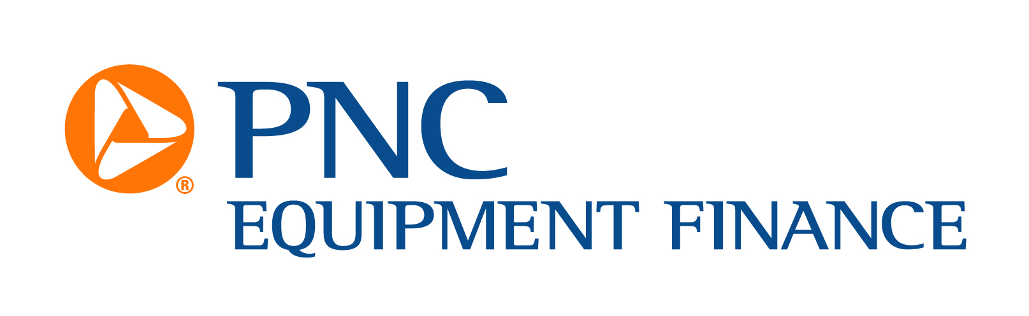


Industry Overview

Slide 10


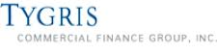





Industry Overview
Entrepreneurs are prevalent, and many have had successful exits
First American acquired by City National Bank
Tygris Commercial Finance acquired by EverBank
ILFC acquired by AIG
McCue acquired by NetSol
Capital Stream acquired by HCL

Slide 11




Industry Overview
Entrepreneurs have started successful leasing companies
    Allegiant
    Boston Financial
    Cole Taylor
    Great America

Slide 12




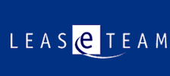

Industry Overview
Entrepreneurs have started successful software and consulting firms
The Alta Group
CHP Consulting
Dominion Leasing Software
Ivory Consulting
LeaseTeam
PayNet

Slide 13
Technology
Industry Overview
Technology/Medical Equipment Manufacturing Captives
Canon Financial Services
Cisco Systems Capital
Dell Financial Services
EMC
Hewlett-Packard Financial Services
IBM Global Financing
Lenovo Global Financial Services
NetApp
Oracle/Sun Microsystems
Siemens
Software & Technology Suppliers
Cassiopae Inc.
CHP Consulting
Constellation Financing Systems
D+H
Dominion Leasing Software
International Decision Systems
Ivory Consulting
LeaseTeam
Linedata Lending and Leasing
NetSol
Odessa Technologies
Oracle
OSG Billing
SunGard

Slide 14

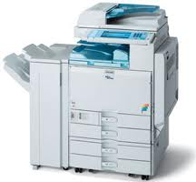
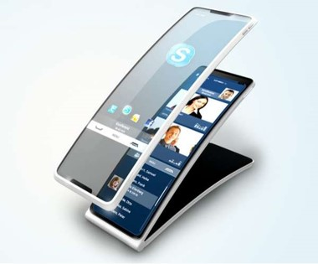
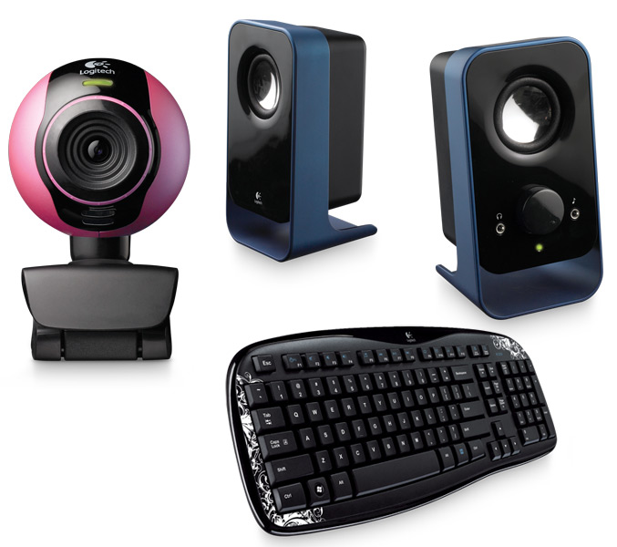
Industry Overview
MARKET SEGMENTS – Small-ticket financing
A market segment generally represented by transactions under $250,000.
Equipment in this segment includes such items as computers, peripherals, office equipment, services, software and telephone equipment.

Slide 15
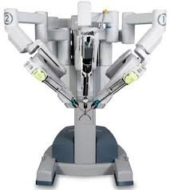

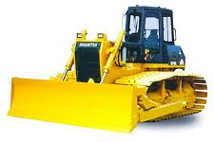
Industry Overview
MARKET SEGMENTS – middle-MARKet financing
A market segment generally represented by financing between $250,000 and $5,000,000.
Equipment in this segment includes solar equipment, computers, software, services, enterprise networks, manufacturing equipment, health services, construction equipment and medical equipment.

Slide 16
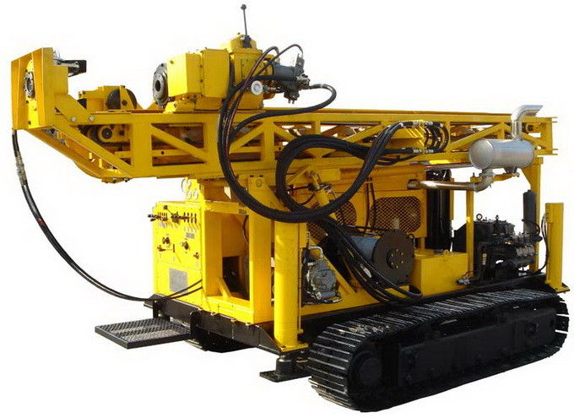
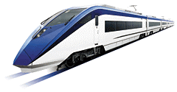
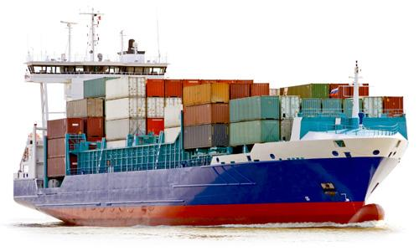
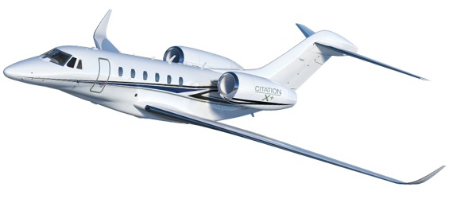
Industry Overview
MARKET SEGMENTS – BIG-TICKET/LARGE-TICKET FINANCING
A market segment represented by financing that usually exceeds $5,000,000.
Equipment financed in this segment includes power plants, railroad equipment, helicopters, commercial and corporate jets, vessels and other transportation equipment, and large mining, and oil and gas exploration.

Slide 17
Why Equipment Finance?

Slide 18
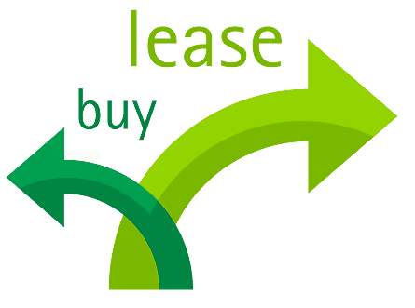
Why Equipment Finance?
Secured Lending and Lease Financing
A loan is a financing agreement that allows a business to acquire, use and own equipment.
  A loan may require a down payment or a pledge of other assets for collateral. Under a loan financing, the borrower remains the owner of the equipment for tax and accounting purposes.
A lease allows a company to acquire and use equipment while conserving its cash flow and lines of credit.
  Leasing also provides a new source of credit with the added benefit of being able to expense your lease payments in most instances. Leasing also can protect against equipment obsolescence when upgrades are included in a lease contract or the equipment is returned to the lessor at the end of the lease term.

Slide 19


Why Equipment Finance?
There are countless reasons why it's a smart idea
to use equipment leasing and finance
Conservation of cash
100% Financing
Preservation of Capital
Hedge Against Inflation
Improved Expense Planning and Business-Cycle Flexibility
Regular Technology Updates
Tax Considerations
Relationships with Equipment Experts
Obsolescence Management
Dependable Asset Management
Product and Service Bundling
Equipment Disposal
For more information, go to:
http://www.equipmentfinanceadvantage.com

Slide 20

Capital Markets

Slide 21
Capital Markets Activity
Capital markets activity plays an important role in the equipment finance industry.
Capital markets activity is any type of external funding required to operate an equipment leasing company.
Capital markets activity includes:
Asset Securitization – Public Issuances and Rule 144A Private Placement Offerings
Syndication – Syndicating a newly originated equipment lease or loan in whole, or in part via Participation Agreement
Portfolio Sale type activity – This could represent a pool of similar type transactions or one-off transactions

Slide 22
Equipment-Based Asset Securitization
Asset Securitization allows for “wholesale institutional” type funding by pooling a number of individual loans with diverse characteristics in terms of geography, customer concentration, asset type and industry diversity.
Classes of Bonds are issued with varying degrees of risk (A,B,C); higher risk means higher rates, and are often times rated by S&P, Moody’s, and Fitch to increase potential pool of buyers.
Payments on underlying loans provide cash flow to service bond payments. The issuer absorbs a first loss position, and excess cash is built up during term – added protection.

Slide 23
Syndications
Syndications: Participations of financial institutions in a sale and/or assignment of all or part of an underlying lease or loan transaction.
Larger equipment financing companies maintain a buy and sell desk . Large equipment leases or loans may require a syndication strategy to meet the customer’s needs and bank’s credit requirements
  Example: ABC Bank Lessor originated an $80 million lease for 1,800 used railcars. They approve a hold position of $40 million on this company; syndicate $40 million to 3rd party investors.
Customer Benefits: Deal with a single lessor, negotiate 1 set of docs; and 1 servicer.
Benefits to Syndicator: Manage credit exposure, fee income, market intelligence
Allocation: Investor is allocated specific assets but tied to the same lease. If financing is for one large asset that can’t be divided (a large aircraft), a Participation Agreement is created.

Slide 24
Portfolio Sale Type Activity
A leasing company can use portfolio sales (in bulk or one-off) to manage the earnings stream or risk characteristics of their portfolio.
May have desire to decrease (or exit completely) their exposure to certain credits, industries, asset types or geographies. Portfolio sale efficiently accomplishes goal.
If equipment value increases during term, a new lessor may be able to assume a higher residual and a sale of the lease results in an immediate gain.
  Examples:
    You booked a deal years ago for a weak credit at a high spread, and the credit has improved and the spreads compressed. Deal can be sold at a big gain.
    A leasing company has $20 million in exposure to Company A and is awarded a new $10 million lease from Company A. Rather than sell the new deal, it may be more profitable to syndicate the lease in the portfolio.

Slide 25

Career Paths in Equipment Finance
Notes:
NOTE TO SPEAKER – Why did you get in to the industry?

Slide 26
Career Paths in Equipment Finance
Lessors
  Executive/Entrepreneur – Corporate leaders and entrepreneurs who set the vision and lead its execution for leasing/lending organizations in banks, manufactures or independent entities.
  Economics/Capital Markets – Provide value-added pricing and economic analysis support by keeping up on developments in the accounting, tax and regulatory environment as well as following market conditions.
  Credit – Includes underwriters who understand the risk dynamics in the equipment leasing and finance industry. Credit employees conduct deal analysis yet wear a business hat. Typically have a macro view of the economy.
  Asset Management – Deep knowledge of equipment assets and customer requirements. Brokerage capability to place equipment in to secondary markets.
  Relationship Manager – Sell lease and loan financing solutions to meet customer equipment financing needs. RMs coordinate the credit approval and documentation process to meet client expectations. Compensation is typically tied to results with commissions paid on funded volume.

Slide 27
Career Paths in Equipment Finance
Suppliers
  Capital Agent – Raises capital and funds leasing and lending companies.
  Software Executive/Entrepreneur – Includes CRM, ERP, originations, pricing, credit analysis and BI software companies, many founded to serve the lending and leasing industry.
  Consultants -- Consulting organizations have a presence in the secured lending and leasing finance industry.
    The Alta Group
    CapGemini
    Deloitte
    GenPact
    McKinsey & Company

Slide 28
Equipment Leasing and Finance Association
  For comprehensive information and resources about the
  equipment leasing and finance industry, go to:
  www.elfaonline.org
  For end-user information, go to:
  www.EquipmentFinanceAdvantage.org.
About the Equipment Leasing and Finance Association (ELFA)
ELFA is the trade association representing financial services companies and manufacturers in the $1.046 trillion U.S. equipment finance sector.
ELFA's mission is to provide member companies with:
a forum for industry development
a platform to advocate for the industry
a principal resource for industry information and ethical standards

Slide 29
Equipment Leasing & Finance Foundation
The Foundation is a 501(c)3 nonprofit organization established by ELFA in 1989.
The only organization dedicated to inspiring thoughtful innovation and contributing to the betterment of the equipment leasing and finance industry.
Several hundred industry research studies, publications and articles including:
    Journal of Equipment Lease Financing
    Monthly Confidence Index (MCI)
    Industry Future Council Report
    State of the Equipment Finance Industry report (SEFI)
    Annual U.S. Economic Outlook report series (updated quarterly)
    Topical reports on market sectors, business efficiency, and more!
The Foundation is supported 100% by charitable donations
  Over $660,000 raised in 2015 from corporate and individual contributions
  Donor benefits include early-release and complimentary copies of research reports
  Non-donors pay a premium for most reports
  For more information visit
  www.LeaseFoundation.org

Slide 30
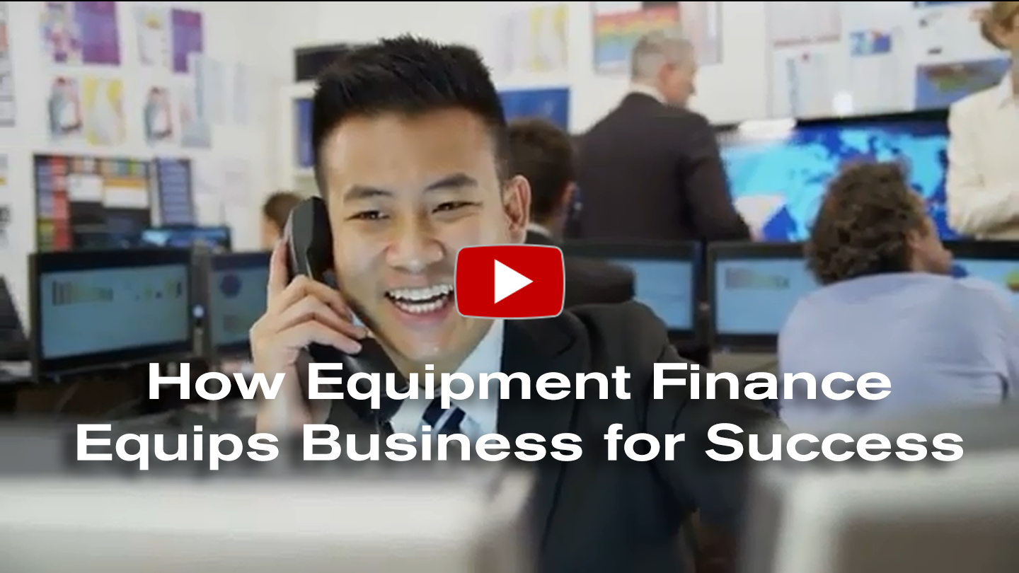
Learn More
Watch the video at www.EquipmentFinanceAdvantage.org/value

Slide 31
Equipment Leasing and Finance
  Questions?

Slide 32
  Additional Slides
  *you may choose to include these in the presentation,
  add a “Resources” section,
  or delete them.

Slide 33



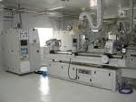
The Benefits of Equipment Finance
INCOME TAX
Alternative Minimum Tax issues
Deduct 100% of Lease Payments
Loss carry forwards
Avoid 4th quarter 40% rule
CASH FLOW
Conserve cash for acquisitions
Match payments to seasonality
Sale/lease back to generate cash
Lowest monthly payment with minimal
outlay
BALANCE SHEET
Industrial revenue bond covenants
Comply with key ratios from lenders
Measured for performance by ROA/ROE
EQUIPMENT
Prefers to use equipment vs. ownership
risks
Trade up to avoid obsolescence
Reduce cash requirements during life

Slide 34
Why Equipment Finance?
There are two basic types of leases.
  Tax Oriented Lease – The provider of the lease financing (the Lessor) purchases the equipment and is the owner of the equipment for tax purposes. The Lessor is entitled to the tax benefits of ownership (depreciation) and as a result can offer a lower rate to the company (Lessee).
  Non-Tax Oriented (Capital) Lease – The Lessor provides 100% financing but the tax ownership remains with the Lessee

Slide 35
Lease Structures
Lease Structures
  Tax Oriented:
    FMV: Capital and Operating
    Terminal Rental Adjustment Clause (TRAC): Trucks, Tractors, Trailers
    Split-TRAC: Operating Lease treatment (lessee guarantees part of residual position)
  Non-Tax Oriented Capital Lease
  Synthetic Lease Structures
  Lease Line Approvals
Loans
  Senior Term Debt
Finance Options
  New and Used Equipment
  Fixed or Floating Rate Options
  Sale and Leaseback

Slide 36
Lease vs. Loan Analysis Assumptions
Lease/Loan Terms: 7 year; monthly payments in arrears
Funding Date: Assumed July 15, 2012
Tax Depreciation: 7 year MACRS (pricing shown with and without 50% bonus depr)
EBO (Lease): Single fixed price early buyout option (EBO) option 12 months prior to end of lease term
End of Lease Options:
  Purchase for Fair Market Value
  Renew lease at Fair Rental Value
  Return equipment to the lessor
Loan Assumptions: Assumes 100% financing; fully amortizing over the term

Slide 37
7 Year Term Economic Analysis
Product | Monthly Payment (% of Equipment Cost) | Full Term Implicit Rate | Fixed EBO Amount- 6 yrs | Implicit Rate to the EBO
Loan | 1.358152% | 3.81% | N/A | N/A
Lease (w/50% bonus) | 1.104986% | -2.08% | $332,487 (33.25%) | 3.13%
Lease (w/o 50% bonus) | 1.128544% | -1.49% | $335,731 (33.57%) | 3.61%

Slide 38
7 Year Term Accounting Analysis
 | Loan Expense
Year | Interest | Depreciation | Total Loan Expense | Lease Expense *
2012 | $15,543.54 | $59,523.81 | $75,067.35 | $56,427.20
2013 | $33,865.79 | $142,857.14 | $176,722.93 | $135,425.29
2014 | $28,859.79 | $142,857.14 | $171,716.93 | $ 135,425.29
2015 | $23,659.69 | $142,857.14 | $166,516.83 | $ 135,425.29
2016 | $18,257.97 | $142,857.14 | $161,115.12 | $ 135,425.29
2017 | $12,646.82 | $142,857.14 | $155,503.96 | $ 135,425.29
2018 | $6,818.11 | $142,857.14 | $149,675.25 | $ 135,425.29
2019 | $1,195.99 | $83,333.33 | $84,529.32 | $78,998.08
* - Straight Line Lease Expense and Off-Balance Sheet Treatment are allowed under current FASB 13 Lease Accounting. Assumes no Bonus depreciation.

Slide 39
Other Considerations
Current and future tax positions
  Anticipated equipment acquisition
  AMT
  Loss Carry Forwards
Financing Caps under Credit Facilities
Lease benefit will be more significant for assets with shorter MACRS
Operational flexibility/Return option under lease financing
Expected changes in accounting rules in 2016
  Leases on balance sheet
  Straight line expense on P&L – eliminated for many equipment leases (vs. Real Estate)

Slide 40
Basics of Tax and Accounting

Slide 41
Tax
Who gets the tax benefits from the equipment?
Is the transaction a true lease (also called a tax lease)? or,
Is it a conditional sales lease (also called a non-tax lease)?

Slide 42
Tax
True Lease
Allows the lessor to use the tax benefits of ownership, including tax depreciation
Allows the lessee to expense rental payments
Conditional Sales Lease - An agreement financing the sale of the equipment that:
Allows the lessee to get the tax depreciation from the equipment
Allows the lessee to deduct the portion of rental payments considered as interest expense

Slide 43
Accounting
The predominant question from an accounting perspective focuses primarily on the lessee.
What is the impact of the lease on the lessee’s financial statements?
Capital Lease
In a capital lease, the equipment is called “leased assets” and the liability, or rental payment, is called “leased obligations.” This lease obligation must appear on the lessee’s balance sheet.
Operating Lease
In an operating lease, which is a lease that fails to meet the criteria set by FAS-13 to be a capital lease, the equipment value and the lease obligation are off the lessee’s balance sheet. The future lease payments required are provided in a note to the audit.

Slide 44
Accounting
FAS 13: Capital vs. Operating Leases
 | Capital Lease (at least one of the 4 criteria must be met) | Operating Lease (all 4 criteria must be met)
Automatic transfer of ownership at end of term | Yes | No
Bargain purchase option | Yes | No
Term | ≥ 75% of useful life | < 75% of useful life
Present value of rentals using the Incremental Borrowing Rate or the Implicit Lease Rate | ≥ 90% of equipment cost | < 90% of equipment cost

