Slide 1
Building Inclusive Workplaces You’ve successfully recruited a diverse workforce, now what?
Presented by…
August 3, 1-2pm EST
August 30, 2023, 1-2pm EST

Slide 2
Housekeeping
Today’s web seminar is being recorded.
All questions should be submitted via the Questions Panel.

Slide 3
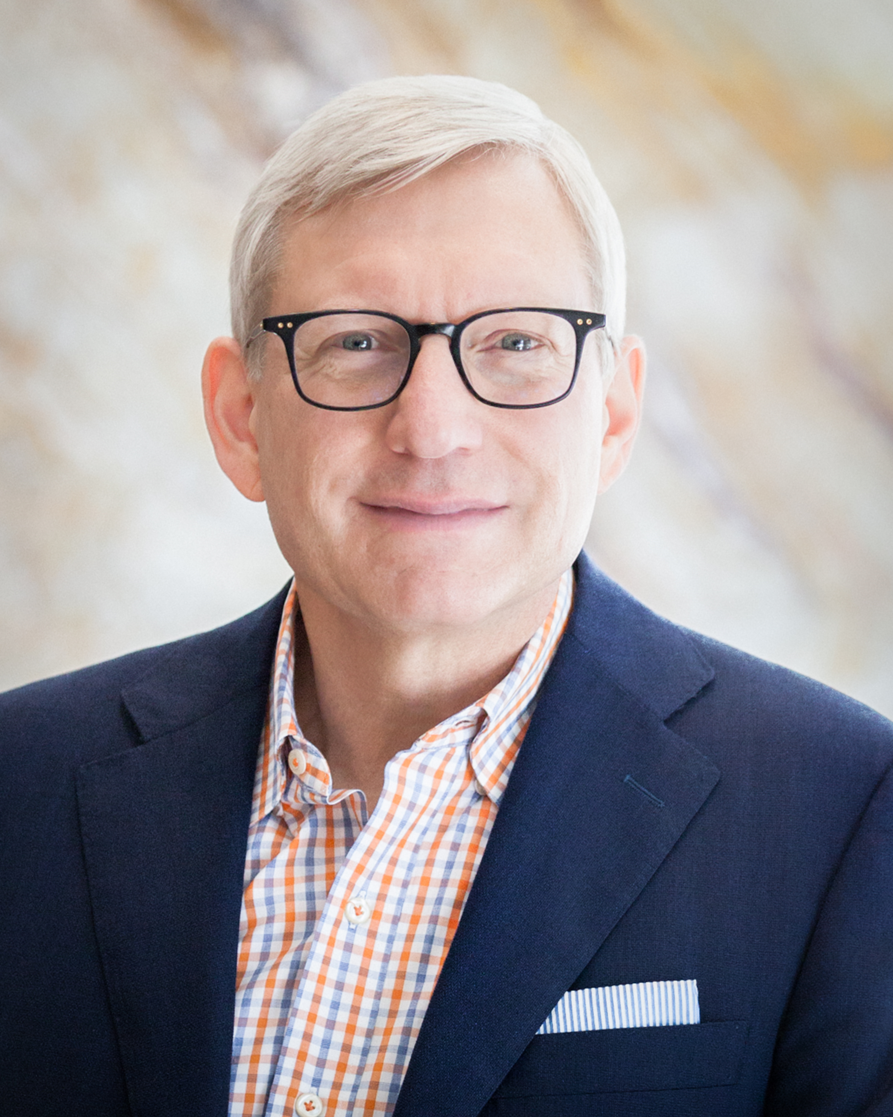
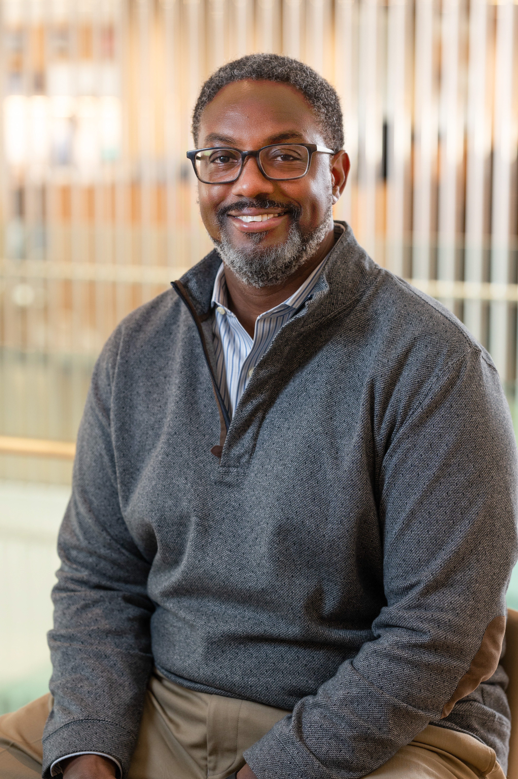
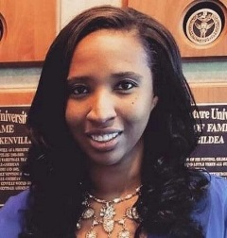
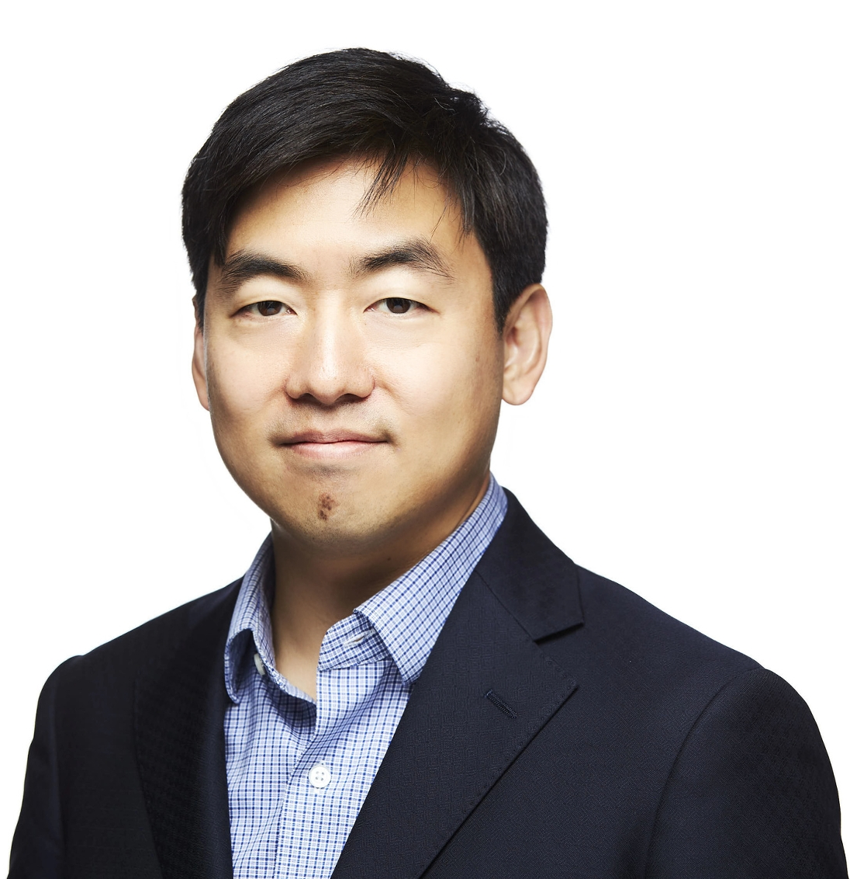
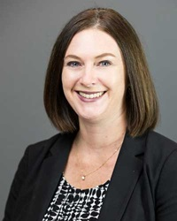
Welcome and Introductions
Scott Thacker
Chief Executive Officer Ivory Consulting Corporation Chair, ELFA Equity Committee
Christopher Johnson SVP & President Pitney Bowes Global Financial Services
Eboni Preston-Laurent Director, Diversity, Equity and Inclusion ELFA
Moto Tohda Vice President / Information Systems Tokyo Century (USA) Inc.
Amy Weum Regional Vice President Farm Credit Leasing

Slide 5
ELFA EQUITY FORUM
SEPTEMBER 13 – 14, 2023
Sheraton New Orleans Hotel New Orleans, LA
Brought to you by…..

Slide 6
Thank You!
Wrap Up
For previously-recorded web seminars go to:
www.elfaonline.org/events/elearning/web-seminars

