Slide 2
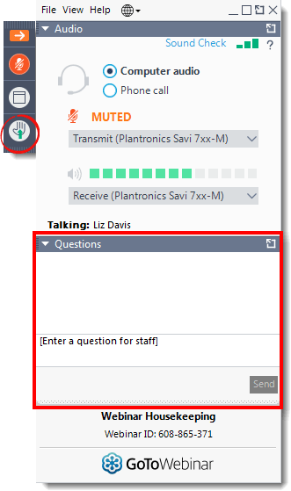
Housekeeping
Today’s web seminar is being recorded.
All questions should be submitted via the Questions Panel.

Slide 3
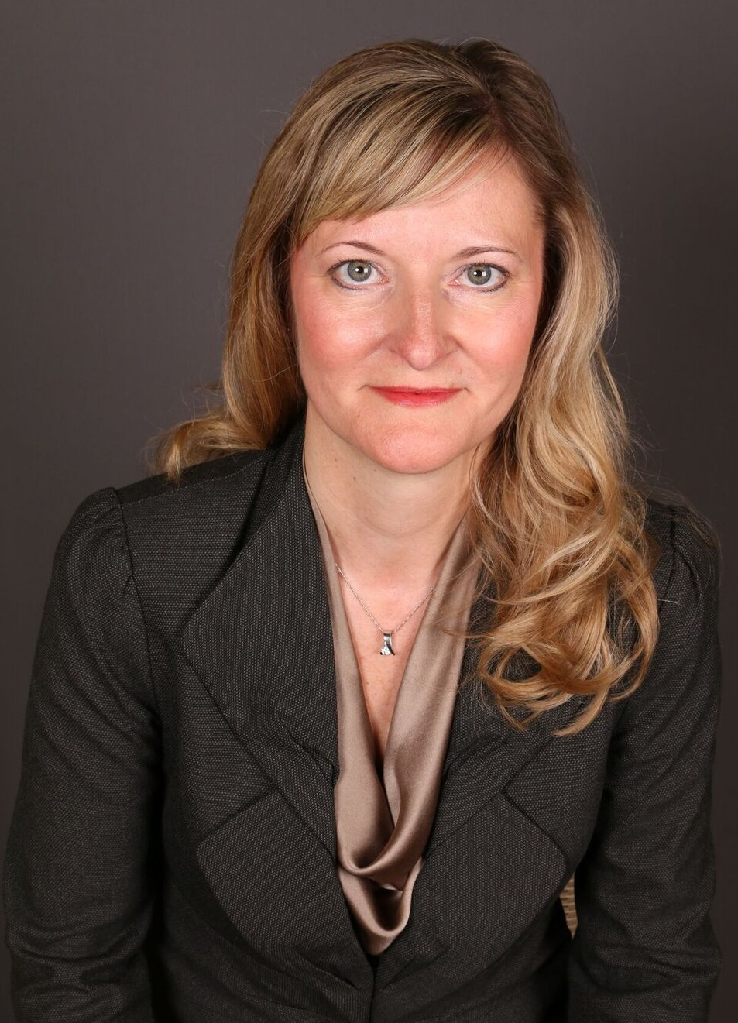
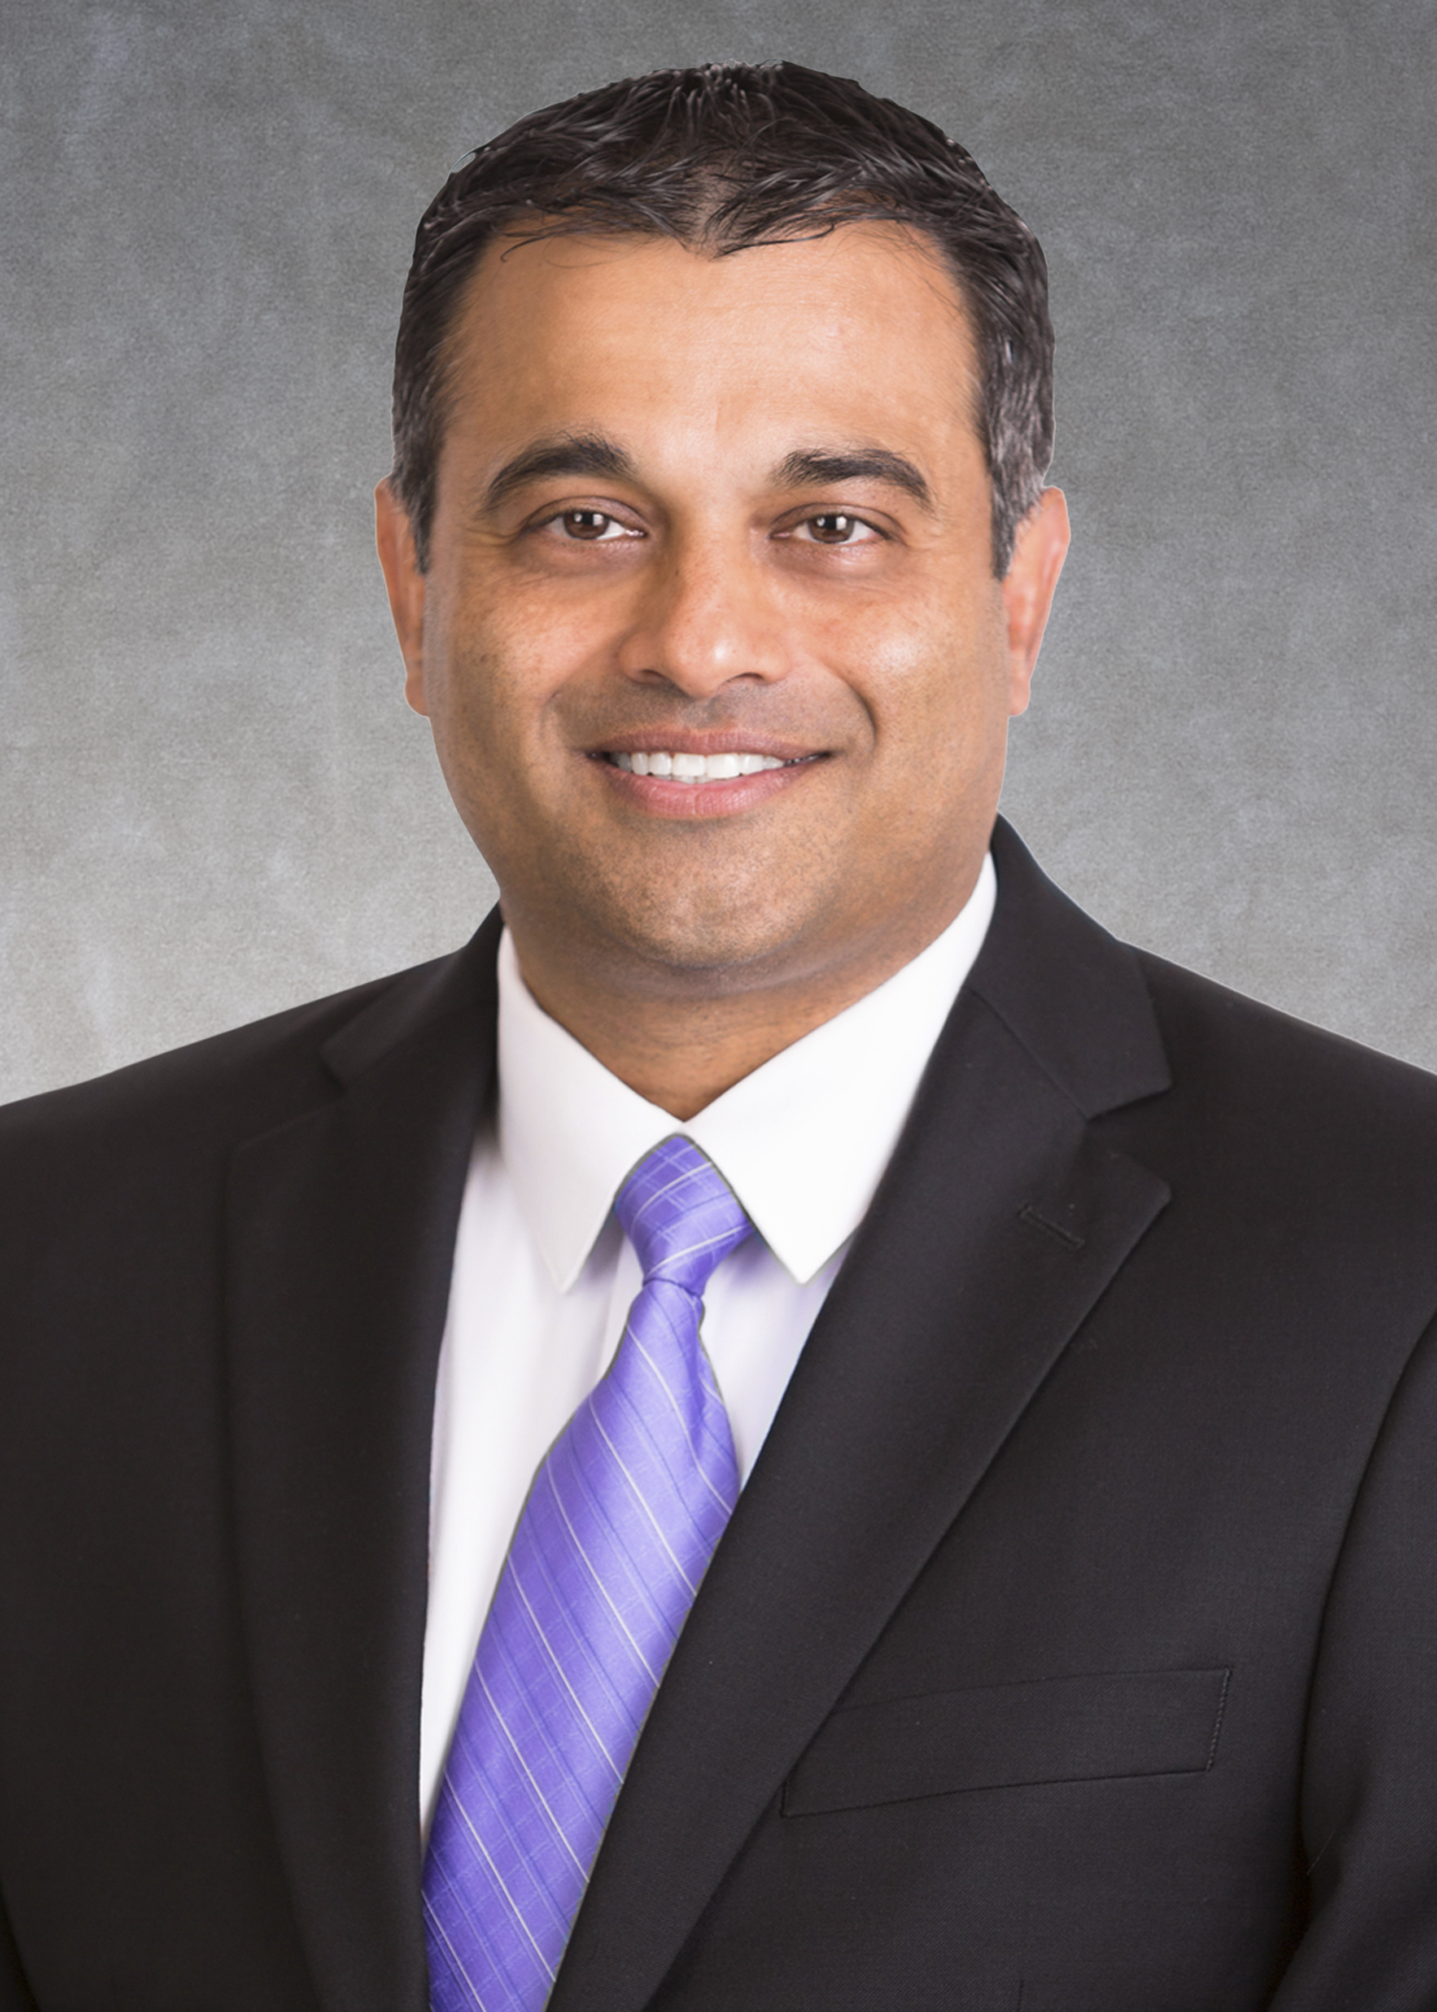
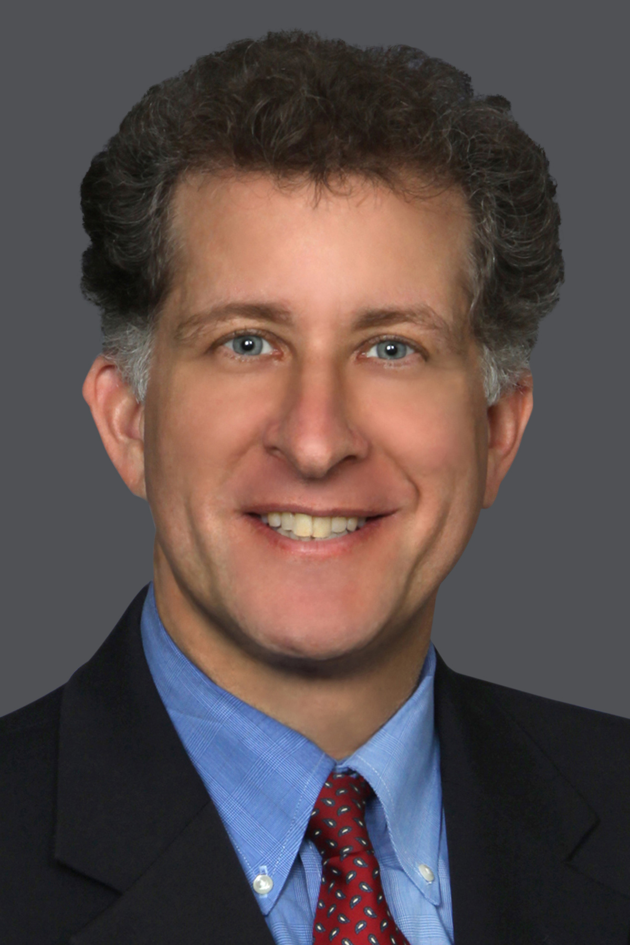
Our Panelists
Scott Riehl Vice President, State Government Relations ELFA
Bonnie Michael Shareholder Baker Donelson
Moorari Shah Partner Sheppard Mullin
Jeff Taft Partner Mayer Brown

Slide 4
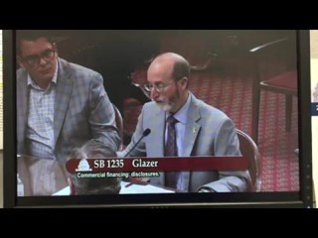
How Did We Get Here…
How Did We Get Here: Non-Stop CA to NY
CA SB 1235 Introduced on February 15, 2018
“Annualized Cost of Capital”
During Contentious May 8, 2018,
Hearing ELFA Elicits “Publicly”
An Intention to Exclude Equipment
Leasing

Slide 5
4 Years In The Fight
Need to Exclude Leasing industry highlighted Again in sponsor’s Senate floor speech
Bill Signed Into Law September
30, 2018
ELFA Filed its 6th and Possible
Final Comments On October 27, 2021
DFPI on 4th Modification

Slide 6
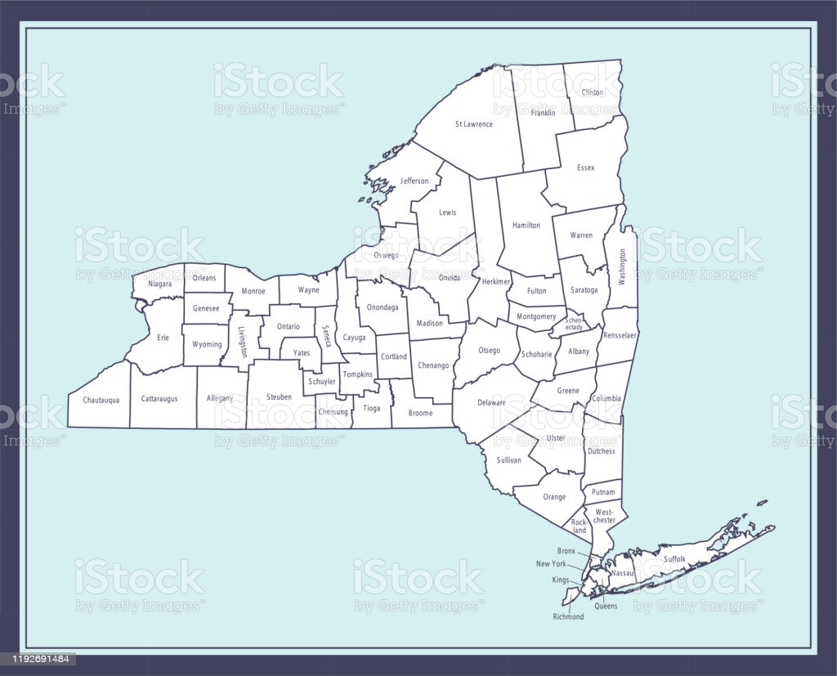
New York and Beyond
New York SB 5470 Introduced May 1, 2019
Did not Include ELFA Hard Fought For True Lease Exemption
Christmas Surprise - Legislation Passed With ELFA
Exemption on December 24, 2020
Amended in Early 2021
Delivered to the DFS with a January 1, 2022, Effective
Date
ELFA Filed its 4th and Possible Final Comments on
December 9, 2021
Continue Threats in New Jersey, Connecticut and
North Carolina

Slide 7
What is in Scope*
Who must comply with NY SB 5470/CA SB 1235?
What transactions are in scope under each law?
Open-end/closed-end (inc. non-true lease)/sales-based/factoring/“other form of financing”
What is the dollar threshold for application of each law?
Does NY SB 5470/CA SB 1235 apply to transactions outside of New York and California, respectively? Is there a “nexus” component?
*See Appendix for specific statutory/regulatory references.

Slide 8
Bank and Other Entity Exemptions
In addition to national banks and other depository institutions, are any other entities exempt from complying with NY SB 5470/CA SB 1235?
Are bank subsidiaries exempt with NY SB 5470/CA SB 1235?

Slide 9
Depository Institution Exemption: Are Disclosures Required?
If an equipment manufacturer, distributor or dealer enters into an installment sale or conditional sale agreement with its customer, which transaction is contemporaneously assigned to a depository institution, is the nondepository institution required to provide the statutory disclosures?
Does the loan, installment sale or conditional sale agreement need to have the depository institution as the named lender under the loan agreement to satisfy depository institution exemption?
If an equipment manufacturer, distributor or dealer refers its customer to a depository institution, who originates the loan, is the referring party required to provide the statutory disclosures even though the financing was extended by a depository institution?
If a nondepository institution, enters into a written agreement with a depository institution to arrange for the extension of commercial financing by the depository institution to a recipient via an online lending platform administered by the nondepository institution, does the nondepository institution need to provide the statutory disclosures?

Slide 10
Commercial Trade Credits
Are commercial trade credits subject to disclosures?
For example, if a commercial equipment customer purchases goods on account (without paying cash up front), but pays the supplier within 30, 60 or 90 days.

Slide 11
Definition of Broker
Is a Dealer who assigns a transaction to a third party financing source a “broker” under the law, even if they don’t receive points or a separate fee from the price of the assigned contract?
New York and California Proposed Regulations: Broker means any person other than a financer or recipient who, for a fee, commission, or other consideration, participates in any financing negotiation; counsels or advises the recipient about financing options; participates in the preparation of any financing documents, including financing applications; contacts the financer on behalf of the recipient other than to refer the recipient, gathers financing application documentation or delivers the documentation to the finance; communicates financing decisions or inquiries from the financer to the recipient; or obtains the recipient’s signature on financing documents.

Slide 12
Inventory
How does a Lender disclose for inventory finance and lines of credit thereunder? Is a new Disclosure required with each takedown?

Slide 13
Timing for Disclosures
When must commercial finance disclosures be provided to the customer? Are revised disclosures required based upon subsequent events?

Slide 14
Disclosure of Fees and Calculation of APR
How is APR to be calculated?
See Appendix See also APR Tool (ffiec.gov)
What are “avoidable fees and charges”?
When do we apply the Closed-Ended Financing versus Lease Financing rules?

Slide 16
What’s Next?
Wrap Up
Join ELFA in 2022 for more Wednesday Webinars, as well as a follow-up to today’s webinar in February!
Happy Holidays!
For previously-recorded web seminars go to:
www.elfaonline.org/events/elearning/web-seminars

Slide 17
Appendix – Page 1
Who must comply/Provider Definitions:
N.Y. Banking Law § 801(h) “ ‘Provider’ means a person who extends a specific offer of commercial financing to a recipient. Unless otherwise exempt, "provider" also includes a person who solicits and presents specific offers of commercial financing on behalf of a third party. For the avoidance of doubt, the extension of a specific offer or provision of disclosures for a commercial financing, in and of itself, shall not be construed to mean that a provider is originating, making, funding or providing commercial financing. ”
Cal. Fin. Code §22800(m) “ ‘Provider’ means a person who extends a specific offer of commercial financing to a recipient. “Provider” also includes a nondepository institution, which enters into a written agreement with a depository institution to arrange for the extension of commercial financing by the depository institution to a recipient via an online lending platform administered by the nondepository institution. The fact that a provider extends a specific offer of commercial financing or lending on behalf of a depository institution shall not be construed to mean that the provider engaged in lending or originated that loan or financing.”
What type of transactions:
N.Y. Banking Law § 801(b) states in part “ ‘Commercial financing’ means open-end financing, closed-end financing, sales-based financing, factoring transaction, or other form of financing, the proceeds of which the recipient does not intend to use primarily for personal, family or household purposes. . . .”
Thresholds:
N.Y. Banking Law § 802(g) “This article shall not apply to, and shall not place any additional requirements or obligations upon, any of the following: . . . (g) an individual commercial financing transaction in an amount over two million five hundred thousand dollars.”
Cal. Fin. Code §22800(n) “ ‘Recipient’ means a person who is presented a specific commercial financing offer by a provider that is equal to or less than five hundred thousand dollars ($500,000).”

Slide 18
Appendix – Page 2
Recipients Relationship:
Proposed Cal. Code of Reg. Title 10, Ch. 3 (Nov. 5, 2021) § 954 –
Recipient’s Relationship to California.
(a) The requirement of section 22802, subdivision (a), of the code, applies only to recipients whose business is principally directed or managed from California.
(b) For the purpose of determining whether a recipient’s business is “principally directed or managed from California” as described in subdivision (a), a provider may rely upon (i) any written representation by the recipient as to whether it is principally directed or managed from California, or (ii) the business address provided by the recipient in the application for financing.

Slide 19
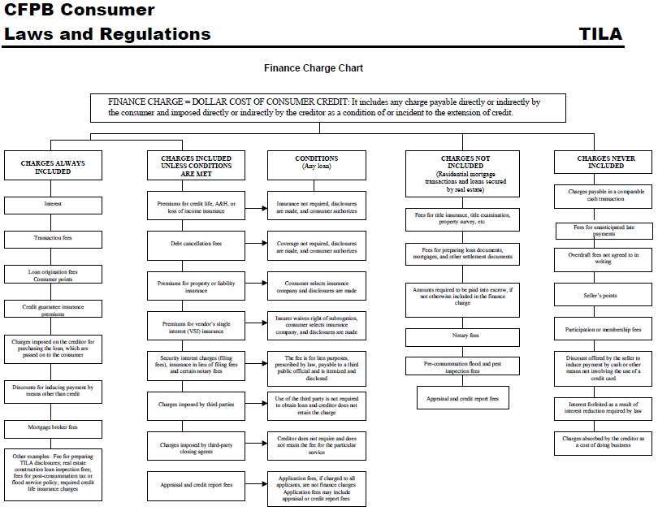
Disclosure of Fees and Calculation of APR
See also Appendix J to Reg Z

